Slide 1
13723 - Cookie Monster

Slide 2
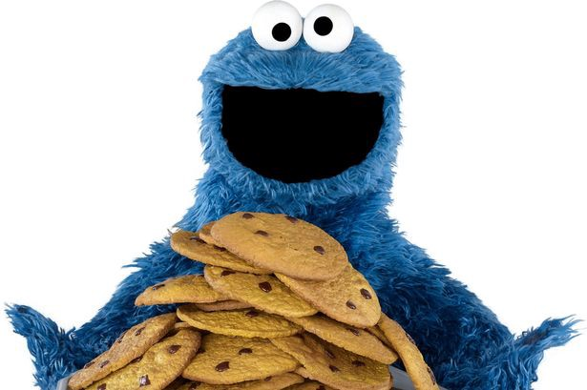
Description
Given n cookies, find out k cookies for cookie monster to eat.
For each cookie, there is a number d_{i}, representing how yummy the ith cookie is.

Slide 3
Description
However, the number d_{i} does not directly be marked on the wrapper of the cookie. Instead, there is a string s_{i} specifying the value of d_{i}.
The format of s_{i} would be like: t₁|t₂|...|t_{m}, where t_{i} is a number shown in hexadecimal.
The value of d_{i} is the concatenation of all decimal notations of t_{i}’s.
For example, if s_{i} = 2C|4|A, then d_{i} = 44410.

Slide 4
Description
Cookie-choosing strategy
For any two cookies, always choose the one with more ‘7’ in d_{i} first.
If there are two cookies containing the same amount of ‘7’ in their d_{i}, choose the one with larger d_{i}.

Slide 5
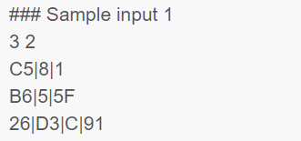
Input
The first line contains two integers n, k, representing the number of cookies and the amount of cookies to choose.
Each of the next n lines contains a string, where the (i+1)th line specifies the value of s_{i}.
Constraints:
1 ≤ n ≤ 1000
1 ≤ d_{i} ≤ 10³⁰⁰
1 ≤ k ≤ n
1 ≤ t_{i} ≤ 7FFFFFFF16 (= 214748364710)
1 ≤ |s_{i}| ≤ 250

Slide 6

Output
Output k lines, that is, the value of d_{i} for each cookie you choose, in the order that the smaller value prints first.

Slide 7
Idea
Sample Input
Sample Output
3 2
C5|8|1
B6|5|5F
26|D3|C|91
19781
3821112145
Transform s_{i} to d_{i}.
Since 1 ≤ d_{i} ≤ 10³⁰⁰, we use char array to store d_{i}.
Find out k cookies.
Compare by cookie-choosing strategy.
Use bubble sort.
Sort k cookies.
Compare by d_{i} value.
Use bubble sort.
1-D int array ans[MAXN]: cookie indexes
0 | 1 | 2
2
1
2
1
0
2
0
2-D char array d[MAXN][MAXLEN]
d[0]
‘1’ | ‘9’ | ‘7’ | ‘8’ | ‘1’ | ‘\0’
‘1’ | ‘9’ | ‘7’ | ‘8’ | ‘1’ | ‘\0’
‘1’ | ‘8’ | ‘2’ | ‘5’ | ‘9’ | ‘5’ | ‘\0’
‘3’ | ‘8’ | ‘2’ | ‘1’ | ‘1’ | ‘1’ | ‘2’ | ‘1’ | ‘4’ | ‘5’ | ‘\0’
‘1’ | ‘9’ | ‘7’ | ‘8’ | ‘1’ | ‘\0’
‘1’ | ‘8’ | ‘2’ | ‘5’ | ‘9’ | ‘5’ | ‘\0’
d[1]
d[2]
1-D int array len[MAXN]
5
5 | 6 | 10
5 | 6
1-D int array cnt[MAXN]
1
1 | 0
1 | 0 | 0

Slide 8
Idea
Transform s_{i} to d_{i}.
Since 1 ≤ d_{i} ≤ 10³⁰⁰, we use char array to store d_{i}.
Find out k cookies.
Compare by cookie-choosing strategy.
Use bubble sort.
Sort k cookies.
Compare by d_{i} value.
Use bubble sort.

Slide 9
Transform s_{i} to d_{i}
i
input
C | 5 | | | 8 | | | 1
Parse input.
Transform hex to decimal (int type).
Transform int to char.
Store to char array.
Maintain info.
j

Slide 10
Transform s_{i} to d_{i}
i
input
C | 5 | | | 8 | | | 1
Parse input.
Transform hex to decimal (int type).
Transform int to char.
Store to char array.
Maintain info.
j

Slide 11
Transform s_{i} to d_{i}
i
input
C | 5 | | | 8 | | | 1
Parse input.
Transform hex to decimal (int type).
Transform int to char.
Store to char array.
Maintain info.
j

Slide 12
Transform s_{i} to d_{i}
i
input
C | 5 | | | 8 | | | 1
Parse input.
Transform hex to decimal (int type).
Transform int to char.
Store to char array.
Maintain info.
j
str_hex
C | 5
Copy from i to j-1
strncpy(str_hex, input+i,j-i);

Slide 13
Transform s_{i} to d_{i}
i
input
C | 5 | | | 8 | | | 1
Parse input.
Transform hex to decimal (int type).
Transform int to char.
Store to char array.
Maintain info.
j
str_hex
C | 5
num = 197 sscanf(str_hex, "%x", &num);

Slide 14
Transform s_{i} to d_{i}
i
input
C | 5 | | | 8 | | | 1
Parse input.
Transform hex to decimal (int type).
Transform int to char.
Store to char array.
Maintain info.
j
str_hex
C | 5
num = 197
str_dec
1 | 9 | 7
sprintf(str_dec, "%d", num);

Slide 15
Transform s_{i} to d_{i}
i
input
C | 5 | | | 8 | | | 1
Parse input.
Transform hex to decimal (int type).
Transform int to char.
Store to char array.
Maintain info.
j
str_hex
C | 5
num = 197
str_dec
1 | 9 | 7
d[n]
1 | 9 | 7
strcat(d[n], str_dec);

Slide 16
Transform s_{i} to d_{i}
i
input
C | 5 | | | 8 | | | 1
Parse input.
Transform hex to decimal (int type).
Transform int to char.
Store to char array.
Maintain info.
j

Slide 17
Transform s_{i} to d_{i}
i
input
C | 5 | | | 8 | | | 1
Parse input.
Transform hex to decimal (int type).
Transform int to char.
Store to char array.
Maintain info.
j
str_hex
8
Copy from i to j-1
strncpy(str_hex, input+i,j-i);

Slide 18
Transform s_{i} to d_{i}
i
input
C | 5 | | | 8 | | | 1
Parse input.
Transform hex to decimal (int type).
Transform int to char.
Store to char array.
Maintain info.
j
str_hex
8
num = 8 sscanf(str_hex, "%x", &num);

Slide 19
Transform s_{i} to d_{i}
i
input
C | 5 | | | 8 | | | 1
Parse input.
Transform hex to decimal (int type).
Transform int to char.
Store to char array.
Maintain info.
j
str_hex
8
num = 8
str_dec
8
sprintf(str_dec, "%d", num);

Slide 20
Transform s_{i} to d_{i}
i
input
C | 5 | | | 8 | | | 1
Parse input.
Transform hex to decimal (int type).
Transform int to char.
Store to char array.
Maintain info.
j
str_hex
8
num = 8
str_dec
8
d[n]
1 | 9 | 7 | 8
strcat(d[n], str_dec);

Slide 21
Transform s_{i} to d_{i}
i
input
C | 5 | | | 8 | | | 1
Parse input.
Transform hex to decimal (int type).
Transform int to char.
Store to char array.
Maintain info.
j

Slide 22
Transform s_{i} to d_{i}
i
input
C | 5 | | | 8 | | | 1
Parse input.
Transform hex to decimal (int type).
Transform int to char.
Store to char array.
Maintain info.
j
str_hex
1
Copy from i to j-1
strncpy(str_hex, input+i,j-i);

Slide 23
Transform s_{i} to d_{i}
i
input
C | 5 | | | 8 | | | 1
Parse input.
Transform hex to decimal (int type).
Transform int to char.
Store to char array.
Maintain info.
j
str_hex
1
num = 1 sscanf(str_hex, "%x", &num);

Slide 24
Transform s_{i} to d_{i}
i
input
C | 5 | | | 8 | | | 1
Parse input.
Transform hex to decimal (int type).
Transform int to char.
Store to char array.
Maintain info.
j
str_hex
1
num = 1
str_dec
1
sprintf(str_dec, "%d", num);

Slide 25
Transform s_{i} to d_{i}
i
input
C | 5 | | | 8 | | | 1
Parse input.
Transform hex to decimal (int type).
Transform int to char.
Store to char array.
Maintain info.
j
str_hex
1
num = 1
str_dec
1
d[n]
1 | 9 | 7 | 8 | 1
strcat(d[n], str_dec);

Slide 26
Transform s_{i} to d_{i}
input
C | 5 | | | 8 | | | 1
Parse input.
Transform hex to decimal (int type).
Transform int to char.
Store to char array.
Maintain info.
d[n]
1 | 9 | 7 | 8 | 1
len[n]=strlen(d[n]);

Slide 27
Transform s_{i} to d_{i}
input
C | 5 | | | 8 | | | 1
Parse input.
Transform hex to decimal (int type).
Transform int to char.
Store to char array.
Maintain info.
d[n]
1 | 9 | 7 | 8 | 1
pos
if (d[n][pos] == '7') cnt[n]++;

Slide 28
Transform s_{i} to d_{i}
input
C | 5 | | | 8 | | | 1
Parse input.
Transform hex to decimal (int type).
Transform int to char.
Store to char array.
Maintain info.
d[n]
1 | 9 | 7 | 8 | 1
pos
if (d[n][pos] == '7') cnt[n]++;

Slide 29
Transform s_{i} to d_{i}
input
C | 5 | | | 8 | | | 1
Parse input.
Transform hex to decimal (int type).
Transform int to char.
Store to char array.
Maintain info.
d[n]
1 | 9 | 7 | 8 | 1
pos
if (d[n][pos] == '7') cnt[n]++;

Slide 30
Transform s_{i} to d_{i}
input
C | 5 | | | 8 | | | 1
Parse input.
Transform hex to decimal (int type).
Transform int to char.
Store to char array.
Maintain info.
d[n]
1 | 9 | 7 | 8 | 1
pos
if (d[n][pos] == '7') cnt[n]++;

Slide 31
Transform s_{i} to d_{i}
input
C | 5 | | | 8 | | | 1
Parse input.
Transform hex to decimal (int type).
Transform int to char.
Store to char array.
Maintain info.
d[n]
1 | 9 | 7 | 8 | 1
pos
if (d[n][pos] == '7') cnt[n]++;

Slide 32
Transform s_{i} to d_{i}
for (int i = 0, j = 0; input[j] != '\0'; i = j+1) {
j = i;
while (input[j] != '|' && input[j] != '\0') j++;
int num = 0;
char str_hex[15]={'\0'};
char str_dec[15]={'\0'};
strncpy(str_hex, input+i, j-i);
sscanf(str_hex, "%x", &num);
sprintf(str_dec, "%d", num);
strcat(d[n], str_dec);
}
len[n]=strlen(d[n]);
for (int pos = 0; pos < len[n]; ++pos) {
if (d[n][pos] == '7') cnt[n]++;
}
Parse input.
Transform hex to decimal (int type).
Transform int to char.
Store to char array.
Maintain info.
i
input
C | 5 | | | 8 | | | 1
j

Slide 33
Transform s_{i} to d_{i}
for (int i = 0, j = 0; input[j] != '\0'; i = j+1) {
j = i;
while (input[j] != '|' && input[j] != '\0') j++;
int num = 0;
char str_hex[15]={'\0'};
char str_dec[15]={'\0'};
strncpy(str_hex, input+i, j-i);
sscanf(str_hex, "%x", &num);
sprintf(str_dec, "%d", num);
strcat(d[n], str_dec);
}
len[n]=strlen(d[n]);
for (int pos = 0; pos < len[n]; ++pos) {
if (d[n][pos] == '7') cnt[n]++;
}
Parse input.
Transform hex to decimal (int type).
Transform int to char.
Store to char array.
Maintain info.
str_hex
C | 5
num = 197

Slide 34
Transform s_{i} to d_{i}
for (int i = 0, j = 0; input[j] != '\0'; i = j+1) {
j = i;
while (input[j] != '|' && input[j] != '\0') j++;
int num = 0;
char str_hex[15]={'\0'};
char str_dec[15]={'\0'};
strncpy(str_hex, input+i, j-i);
sscanf(str_hex, "%x", &num);
sprintf(str_dec, "%d", num);
strcat(d[n], str_dec);
}
len[n]=strlen(d[n]);
for (int pos = 0; pos < len[n]; ++pos) {
if (d[n][pos] == '7') cnt[n]++;
}
Parse input.
Transform hex to decimal (int type).
Transform int to char.
Store to char array.
Maintain info.
str_hex
C | 5
num = 197
str_dec
1 | 9 | 7

Slide 35
Transform s_{i} to d_{i}
for (int i = 0, j = 0; input[j] != '\0'; i = j+1) {
j = i;
while (input[j] != '|' && input[j] != '\0') j++;
int num = 0;
char str_hex[15]={'\0'};
char str_dec[15]={'\0'};
strncpy(str_hex, input+i, j-i);
sscanf(str_hex, "%x", &num);
sprintf(str_dec, "%d", num);
strcat(d[n], str_dec);
}
len[n]=strlen(d[n]);
for (int pos = 0; pos < len[n]; ++pos) {
if (d[n][pos] == '7') cnt[n]++;
}
Parse input.
Transform hex to decimal (int type).
Transform int to char.
Store to char array.
Maintain info.
str_dec
1 | 9 | 7
d[n]
1 | 9 | 7

Slide 36
Transform s_{i} to d_{i}
for (int i = 0, j = 0; input[j] != '\0'; i = j+1) {
j = i;
while (input[j] != '|' && input[j] != '\0') j++;
int num = 0;
char str_hex[15]={'\0'};
char str_dec[15]={'\0'};
strncpy(str_hex, input+i, j-i);
sscanf(str_hex, "%x", &num);
sprintf(str_dec, "%d", num);
strcat(d[n], str_dec);
}
len[n]=strlen(d[n]);
for (int pos = 0; pos < len[n]; ++pos) {
if (d[n][pos] == '7') cnt[n]++;
}
Parse input.
Transform hex to decimal (int type).
Transform int to char.
Store to char array.
Maintain info.
d[n]
1 | 9 | 7 | 8 | 1
pos

Slide 37
Transform s_{i} to d_{i}
for (int i = 0, j = 0; input[j] != '\0'; i = j+1) {
j = i;
while (input[j] != '|' && input[j] != '\0') j++;
int num = 0;
char str_hex[15]={'\0'};
char str_dec[15]={'\0'};
strncpy(str_hex, input+i, j-i);
sscanf(str_hex, "%x", &num);
sprintf(str_dec, "%d", num);
strcat(d[n], str_dec);
}
len[n]=strlen(d[n]);
for (int pos = 0; pos < len[n]; ++pos) {
if (d[n][pos] == '7') cnt[n]++;
}
Parse input.
Transform hex to decimal (int type).
Transform int to char.
Store to char array.
Maintain info.

Slide 38
Idea
Transform s_{i} to d_{i}.
Since 1 ≤ d_{i} ≤ 10³⁰⁰, we use char array to store d_{i}.
Find out k cookies.
Compare by cookie-choosing strategy.
Use bubble sort.
Sort k cookies.
Compare by d_{i} value.
Use bubble sort.

Slide 39
Find out k cookies
Cookie-choosing strategy
For any two cookies, always choose the one with more ‘7’ in d_{i} first.
➔ Compare numbers of 7 first.
If there are two cookies containing the same amount of ‘7’ in their d_{i}, choose the one with larger d_{i}.
➔ If numbers of 7 are the same, compare d_{i} values.

Slide 40
Find out k cookies
void find_ans() {
for (int j = 0; j < N; ++j)
ans[j] = j;
bubble_sort_1();
…
}
Use bubble sort.
Compare by cookie-choosing strategy.
Compare # of ‘7’s
Compare length
Compare value
//phase 1: sort the whole N cookies
void bubble_sort_1() {
for (int i = 0; i < N-1; ++i) {
for (int j = 0; j < N-1-i; ++j) {
if(cmp_1(ans[j],ans[j+1])>0) {
int temp = ans[j];
ans[j] = ans[j+1];
ans[j+1] = temp;
}
}
}
}

Slide 41
Find out k cookies
//check if "idx_a" > "idx_b" in terms of
// both # of ‘7’s and di values:
//if "idx_a" > "idx_b", then for "idx_a"
// 1. less ‘7’s
// 2. smaller di (under same # of ‘7’s)
int cmp_1(int idx_a, int idx_b) {
if (cnt[idx_a] < cnt[idx_b]) return 1;
else if (cnt[idx_a] > cnt[idx_b]) return -1;
else { //equal # of ‘7’s
if (len[idx_a] < len[idx_b]) return 1;
else if (len[idx_a] > len[idx_b]) return -1;
else { //equal length
int res = strcmp(d[idx_a], d[idx_b]);
if (res < 0) return 1;
else if (res > 0) return -1;
else return 0;
}
}
}
Use bubble sort.
Compare by cookie-choosing strategy.
Compare # of ‘7’s
Compare length
Compare value

Slide 42
Find out k cookies
//check if "idx_a" > "idx_b" in terms of
// both # of ‘7’s and di values:
//if "idx_a" > "idx_b", then for "idx_a"
// 1. less ‘7’s
// 2. smaller di (under same # of ‘7’s)
int cmp_1(int idx_a, int idx_b) {
if (cnt[idx_a] < cnt[idx_b]) return 1;
else if (cnt[idx_a] > cnt[idx_b]) return -1;
else { //equal # of ‘7’s
if (len[idx_a] < len[idx_b]) return 1;
else if (len[idx_a] > len[idx_b]) return -1;
else { //equal length
int res = strcmp(d[idx_a], d[idx_b]);
if (res < 0) return 1;
else if (res > 0) return -1;
else return 0;
}
}
}
Use bubble sort.
Compare by cookie-choosing strategy.
Compare # of ‘7’s
Compare length
Compare value

Slide 43
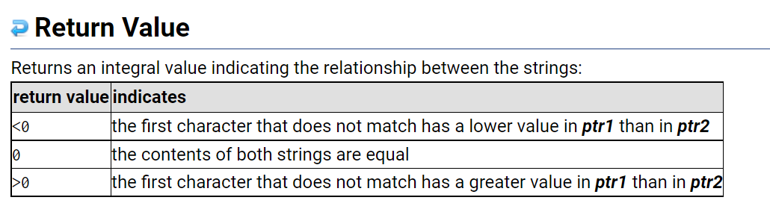
Find out k cookies
//check if "idx_a" > "idx_b" in terms of
// both # of ‘7’s and di values:
//if "idx_a" > "idx_b", then for "idx_a"
// 1. less ‘7’s
// 2. smaller di (under same # of ‘7’s)
int cmp_1(int idx_a, int idx_b) {
if (cnt[idx_a] < cnt[idx_b]) return 1;
else if (cnt[idx_a] > cnt[idx_b]) return -1;
else { //equal # of ‘7’s
if (len[idx_a] < len[idx_b]) return 1;
else if (len[idx_a] > len[idx_b]) return -1;
else { //equal length
int res = strcmp(d[idx_a], d[idx_b]);
if (res < 0) return 1;
else if (res > 0) return -1;
else return 0;
}
}
}
Use bubble sort.
Compare by cookie-choosing strategy.
Compare # of ‘7’s
Compare length
Compare value

Slide 44
Find out k cookies
//check if "idx_a" > "idx_b" in terms of
// both # of ‘7’s and di values:
//if "idx_a" > "idx_b", then for "idx_a"
// 1. less ‘7’s
// 2. smaller di (under same # of ‘7’s)
int cmp_1(int idx_a, int idx_b) {
if (cnt[idx_a] < cnt[idx_b]) return 1;
else if (cnt[idx_a] > cnt[idx_b]) return -1;
else { //equal # of ‘7’s
if (len[idx_a] < len[idx_b]) return 1;
else if (len[idx_a] > len[idx_b]) return -1;
else { //equal length
int res = strcmp(d[idx_a], d[idx_b]);
if (res < 0) return 1;
else if (res > 0) return -1;
else return 0;
}
}
}
Use bubble sort.
Compare by cookie-choosing strategy.
Compare # of ‘7’s
Compare length
Compare value

Slide 45
Idea
Transform s_{i} to d_{i}.
Since 1 ≤ d_{i} ≤ 10³⁰⁰, we use char array to store d_{i}.
Find out k cookies.
Compare by cookie-choosing strategy.
Use bubble sort.
Sort k cookies.
Compare by d_{i} value.
Use bubble sort.

Slide 46
Sort k cookies
//phase 2: sort the first K cookies
void bubble_sort_2() {
for (int i = 0; i < K-1; ++i) {
for (int j = 0; j < K-1-i; ++j) {
if(cmp_2(ans[j],ans[j+1])>0) {
int temp = ans[j];
ans[j] = ans[j+1];
ans[j+1] = temp;
}
}
}
}
Use bubble sort.
Compare by value.

Slide 47
Sort k cookies
//check if "idx_a" > "idx_b" in terms of di values only:
//if "idx_a" > "idx_b", then for "idx_a"
// 1. larger di
int cmp_2(int idx_a, int idx_b) {
if (len[idx_a] > len[idx_b]) return 1;
else if (len[idx_a] < len[idx_b]) return -1;
else return strcmp(d[idx_a], d[idx_b]); //equal length
}
Use bubble sort.
Compare by value.

Slide 48
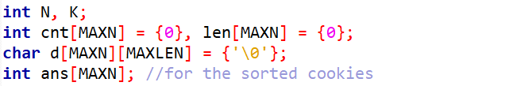
Code – Variable declaration

Slide 49
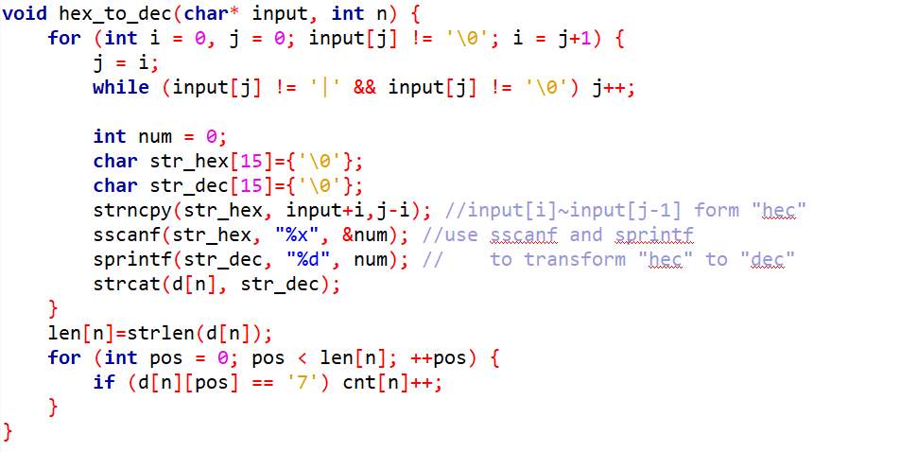
Code – hex_to_dec()

Slide 50
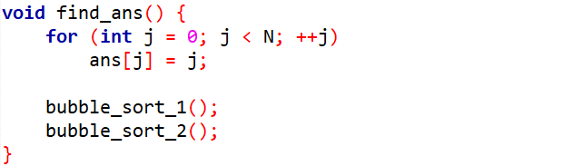
Code – find_ans()

Slide 51
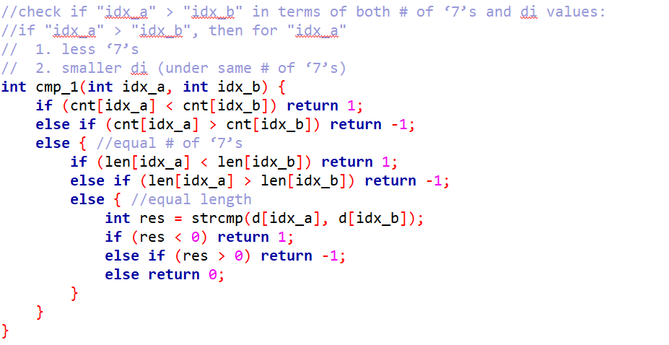
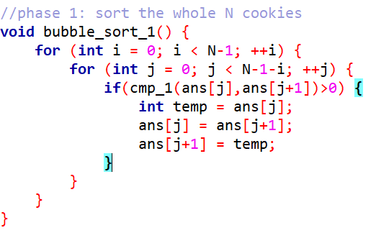
Code – cmp_1() & bubble_sort_1 ()

Slide 52
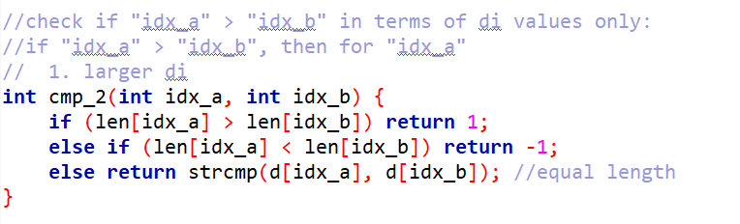
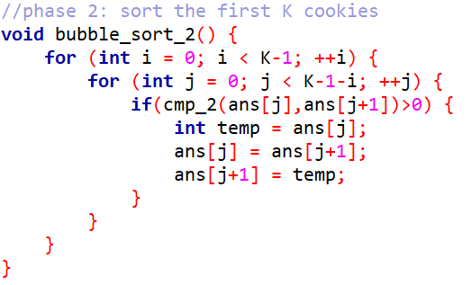
Code – cmp_2() & bubble_sort_2 ()

Slide 53
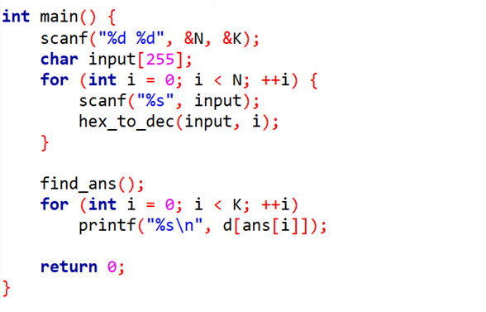
Code – main()

